Slide 1
Bridges From 802.x to 802.y
Prepared by
Divya K S
Adi Shankara Institute of Engineering & Technology
Kalady

Slide 2
Bridges are a data link layer device and can connect to different networks as well as connect different networks of different types.
Bridges from 802.x to 802.y where x & y may both be Ethernet or one can be Ethernet and other may be a token ring, etc.

Slide 3
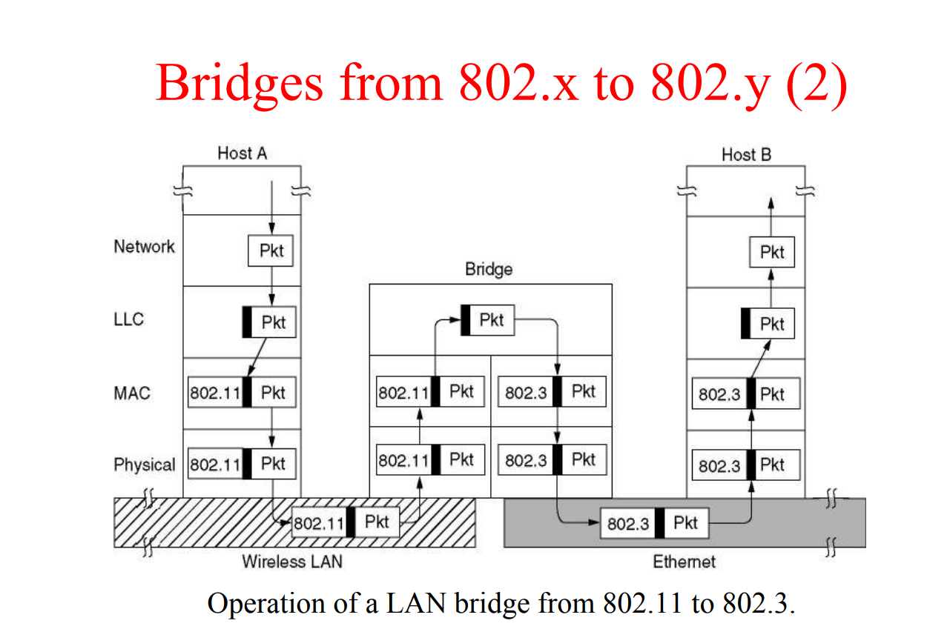

Slide 4
Note that a bridge connecting k different LANs will have k different MAC sublayers and k different physical layers, one for each type.
There are many difficulties that one encounters when trying to build a bridge between the various 802 LANs (and MANs)
Each of the LANs uses a different frame format

Slide 5
Problems
Any copying between different LANs requires reformatting.
Data rate problem.
Different 802 LANs have different maximum frame lengths.
Security problem.
Quality of service.

Slide 6
1. Copying between different LANs
Each of the LANs uses a different frame format.
Unlike the differences between Ethernet, token bus, and token ring, which were due to history and big corporate egos, here the differences are to some extent legitimate.
As a result, any copying between different LANs requires reformatting, which takes CPU time, requires a new checksum calculation.
It introduces the possibility of undetected errors due to bad bits in the bridge's memory.

Slide 7
2. Data rate problem
The interconnected LANs do not necessarily run at the same data rate.
When forwarding a long run of back-to-back frames from a fast LAN to a slower one, the bridge will not be able to get rid of the frames as fast as they come in.
Bridges that connect three or more LANs have a similar problem when several LANs are trying to feed the same output LAN at the same time even if all the LANs run at the same speed.

Slide 8
3. Different 802 LANs have different maximum frame lengths.
An obvious problem arises when a long frame must be forwarded onto a LAN that cannot accept it.
There is no provision for reassembling frames out of smaller units. This is not to say that such protocols could not be devised.
Frames that are too large to be forwarded must be discarded. So basically, there is no solution for this.

Slide 9
4. Security problems
Both 802.11 and 802.16 support encryption in the data link layer, but the Ethernet does not.
This means that the various encryption services available to the wireless networks are lost when traffic passes over an Ethernet.
One solution to the security problem is to do encryption in a higher layer.

Slide 10
5. Quality of service
Both 802.11 and 802.16 provide it in various forms, the former using PCF mode and the latter using constant bit rate connections.
Ethernet has no concept of quality of service.
So the traffic from either of the others will lose its quality of service when passing over an Ethernet.

Slide 11
THANK YOU.

